Slide 1
Exceptions and Java Collections

Slide 2
Key Topics
Exceptions
Data Structures Introduction
The Java Collection Framework
Maps
Comparing Objects

Slide 3
Exceptions

Slide 4
Exception
Exception: a Java object that wraps an event which causes an interruption to the normal flow of a program
Commonly a result of a programing error
Error: Java objects that wrap events from which a Java program should not be expected to recover
OutOfMemoryError
StackOverflowError

Slide 5
Checked Exceptions
Checked exceptions are checked for at compile time – your program will not execute at all if one is found
any subclass of Exception which is NOT a subclass of RuntimeException is checked
Represents occasions where it is reasonable to anticipate an unexpected condition
Must have be either declared or caught
Declared: public int methodName()throws NameOfException{
Caught: try{ … }catch(NameOfException ex){}
Typically used when your program is interacting with outside resources i.e. a database, file system etc.
FileNotFoundException, IOException

Slide 6
Unchecked Exceptions
Unchecked exceptions are not discovered until runtime – can cause crashing during execution
Also referred to as RuntimeExceptions
Any subclass of RuntimeException is unchecked
They can be caught or declared, but it is optional
Typically result from internal programming practices, deliberate or not.
Examples include: ClassCastException, ArrayIndexOutOfBoundsException, ArithmeticException

Slide 7
Exceptions
Throwable
Should not be
recoverable
Should be
recoverable
Exception
Error
There are over
100 subclasses!
RuntimeException
It and its subclasses are unchecked exceptions and is associated with logical errors
ArithmeticException
ClassCastException
IndexOutOfBoundsException
checked
unchecked

Slide 8
Using Exceptions

Slide 9
Declaring an Exception
To declare an exception, use the throws keyword
What does this do? It “throws” the exception to the calling method for the caller to handle
Access Mod Non-Access Mod Return Type Name (Parameters) throws declaration {
// method body
}
Ex:
private static int sumOddNumbers (int num1, int num2)
throws EvenNumberException {
if (num1 % 2 == 0 || num2 % 2 == 0) {
throw new EvenNumberException(“Input was Even!”);
}
return num1 + num2;
}

Slide 10
Handling an Exception
Although you can keep “throwing” an exception down the call stack, you will eventually have to handle it using a try/catch block
public static void main(String[] args){
try{
// try to call method that may throw exception
sumOddNumbers(1,2);
}
// catch exception if thrown
catch(EvenNumberException ex){
ex.printStackTrace();
}
finally{ // Finally blocks will ALWAYS run }
}

Slide 11
Creating and Using Custom Exceptions
public class EvenNumberException extends Exception{
public EvenNumberException(String message){
super(message);
}
public EvenNumberException(){}
}
public class DoStuff{
public static void main(String[] args){
try{
sumOddNumbers(1,2);
}catch(EvenNumberException ex){
ex.printStackTrace();
} catch(Exception ex){
ex.printStackTrace();
} finally{ // Finally blocks will ALWAYS run}
}
public static int sumOddNumbers(int num1, int num2)throws EvenNumberException{
if(num1 % 2 == 0 || num2 % 2 == 0)
throw new EvenNumberException(“Input is even”);
return num1 + num2;
}
}

Slide 12
Stacktraces

Slide 13
Reading Stacktraces
When an application runs, its instructions are stacked on top of each other, and resolved top-to-bottom.
When the application calls a function, that function is placed “on top of the stack”. The function must be resolved before execution can continue.
If an exception is thrown, a stacktrace is generated
Stacktrace: a report that traces the method calls that generated the exception back through the application stack.

Slide 14
Reading Stacktraces
Exception in thread "main" java.lang.ArithmeticException: / by zero
at samples.Test.division(Test.java:11)
at samples.Test.mathInvoker(Test.java:8)
at samples.Test.main(Test.java:5)
- The exception type (Arithmetic Exception)
- A description of the exception (if possible)
- The method where the exception probably occurred
- The line of code where the exception occurred or where the next function was called
main() invoked mathInvoker() at line 5, which invoked division() at line 8, which generated an exception at line 11.

Slide 15
Stacktrace Example
public class Test {
public static void main(String[] args) {
mathInvoker(1, 0);
}
public static void mathInvoker(int a, int b) {
division(a, b);
}
public static void division(int a, int b) {
System.out.println("a / b:" + (a / b));
}
}
Exception in thread "main" java.lang.ArithmeticException: / by zero
at samples.Test.division(Test.java:11)
at samples.Test.mathInvoker(Test.java:8)
at samples.Test.main(Test.java:5)

Slide 16
Recall
What is the difference between an Error and an Exception?
What are Runtime Exceptions?
What is the difference between declaring and handling an exception?
What is a stracktrace?

Slide 17
Data Structures Introduction

Slide 18
What is a Data Structure?
A data structure is a format for storing and managing more than one piece of data
Arrays are data structures
Elements can be removed, added, searched for, etc
Each data structure has its own way of storing and working with the data it holds
There are two fundamental ways of storing information in data structures:
In arrays
With nodes

Slide 19
Array Based Structures
array-based structures simply use an array to store the data
Because arrays are used, data is saved in positions that each have corresponding indices.
Array-based structures further build on an array by modifying how the values are accessed and worked with
An arraylist is an array-based structure. It uses an array to store the data but defines a specific way of managing and accessing the data
Info
Index: 0
Info
Index: 1
Info
Index: 2
Info
Index: 3
Info
Index: 4
Info
Index: 5

Slide 20
Node Based Structures
A node-based structure stores information in node objects which may have one or more references to other node objects.
Recall that reference variables point to an object’s location in memory
Node objects usually contain data as well as reference variables that point to the previous and/or next node in the structure
data variable
ref variable
data variable
ref variable

Slide 21
Java Collection Framework

Slide 22
The Collection Interface
The Java Collection Framework provides built-in data structures for the user to work with
It contains interfaces that define what behavior the data structures should have
It also contains concrete classes that represent each data structure
The main branch of the Collection Framework is the collection hierarchy. Its root is the Collection interface and it defines a set of behaviors common to all collections in Java (except Maps, which are in another branch entirely)
https://docs.oracle.com/javase/8/docs/api/java/util/Collection.html
Collections can be broken down into three types: Lists, Sets, and Queues

Slide 23
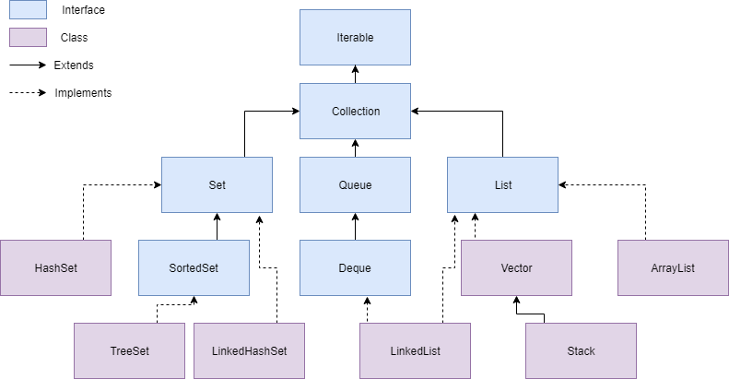
Collection Hierarchy

Slide 24
Important Interfaces in the Collection Framework
Iterable – Requires that every collection can be iterated over (each element can be accessed, one by one)
Collection – An Interface in Java that defines an architecture for storing and manipulating objects
Set – A collection which cannot contain duplicate elements
Queue – An ordered collection of objects which utilizes a first-in-first-out principle
List – An ordered collection of objects which utilizes indexes

Slide 25
Maps

Slide 26
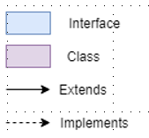
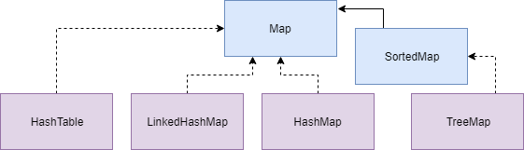
Map Hierarchy
Although maps are a branch of the Collection Framework, they are not collections
Collections are groups of objects
Maps are groups of key-value pairs

Slide 27
Creating Java Maps
When you create a collection, you specify the type of objects it will hold. This is due to the use of Generics in Collections. More on this soon!
When you create a map, you must specify the type of key and the type of value that it will hold
List<String> list = new ArrayList<> ();
Map<String, Integer> map = new HashMap<> ();

Slide 28
Map vs Collection Methods
 | Collection | Map
Add an element | add(object) | put(key, value)
Remove an element | remove(object) | remove(key)
Iterate over data structure | For-each loop | get something iterable using either keySet(), values(), or entrySet() then use for-each loop

Slide 29
Recall
What is a data structure?
What is the Java Collection Framework?
What is a Set, Queue, List, and Map?
What are some methods I can use with collections? With Maps?

